Slide 1
Final Engagement
Attack, Defense & Analysis of a Vulnerable Network
Senthil, Ken, Shem & Coneisha- Sept 13 2021
1

Slide 2

Table of Contents
This document contains the following resources:
Network Topology & Critical Vulnerabilities
Exploits Used
Alerts Implemented
Hardening
2

Slide 3

Network Topology
& Critical Vulnerabilities

Slide 4

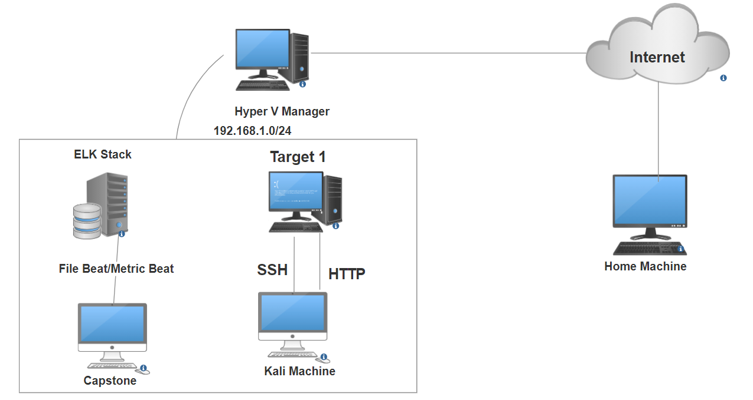
Network Topology
Network Address Range: 192.168.1.0/24
Gateway: 192.168.1.1
Machines
IPv4: 192.168.1.90
OS: Debian Kali 5.4.0 Hostname: Kali
IPv4: 192.168.1.110
OS: Debian GNU/Linux 8 Hostname: Target 1
IPv4: 192.168.1.105
OS: Ubuntu 18.04 Hostname: Capstone
IPv4: 192.168.1.100
OS: Ubuntu 18.04 Hostname: ELK

Slide 5
Critical Vulnerabilities: Target 1
Our assessment uncovered the following critical vulnerabilities in Target 1.
Vulnerability | Description | Impact
Weak Passwords | Was able to find passwords using dictionary brute force against web form | Allowed attacker to gain access to protected web directories
Wordpress User Enumeration | Utilized enum4linux to gather user information for the web server | Allows attacker to gather usernames to gain access to the web server
Unprotected and Unsalted Hash | Used Rainbow table to compare an unprotected hash to a corresponding password | Allowed attacker to gain access to WebDav to alter contents of web server
Privilege Escalation | Used Stevens sudo Python access to escalate from ‘Steven to root’ | Allowed privilege escalation to root
5

Slide 6
Exploits Used

Slide 7
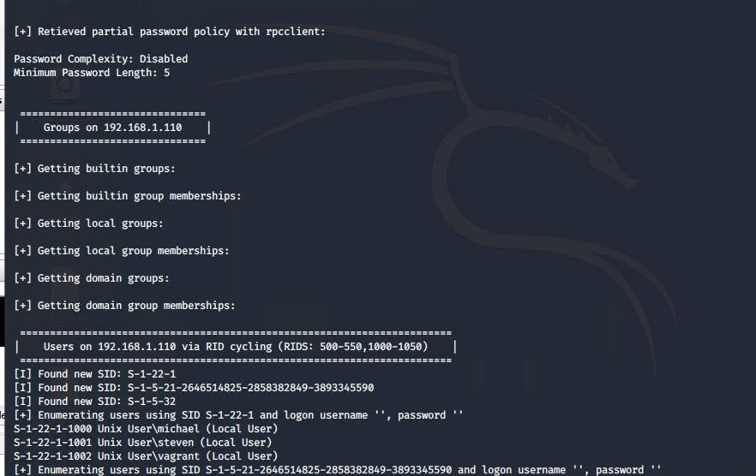
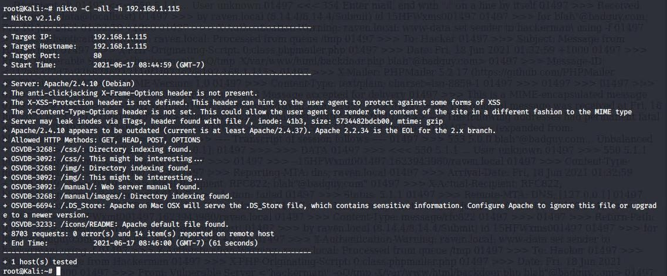
Exploitation: Wordpress User Enumeration
Summarize the following:
How did you exploit the vulnerability?
Target 1
linux -a 192.168.1.110
What did the exploit achieve?
Gained access to the server via SSH

Slide 8
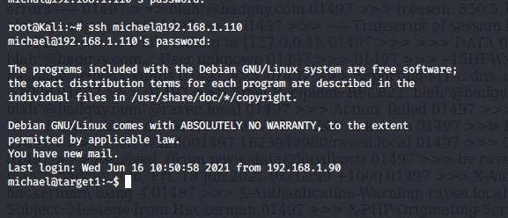
Exploitation: Weak Passwords
Summarize the following:
How did you exploit the vulnerability?
Manual brute force;
Username: Michael
Password: michael
What did the exploit achieve?
Grants access to michaels account via SSH

Slide 9


Exploitation: Unprotected and Unsalted Hash
Summarize the following:
How did you exploit the vulnerability?
Used JohnTheRipper to brute force the hash located within the MySQL database.
What did the exploit achieve?
Gained the ability to ssh from Michael to Steven to gain further privileges

Slide 10
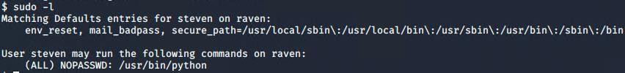
Exploitation: Privilege Escalation
Summarize the following:
How did you exploit the vulnerability?
Used sudo -l to gain information needed to perform escalation
Used sudo Python access to escalate to root
sudo python -c 'import pty; pty.spawn("bin/bash")'
What did the exploit achieve?
Achieved root access on the machine

Slide 11
The End

